Slide 1

FSM and FSMD
ECE381(CAD), Lecture 8:
Mehdi Modarressi
Department of Electrical and Computer Engineering,
University of Tehran
Some pictures and examples are taken from “FPGA Prototyping By VHDL Examples- Xilinx Spartan-3 Version”

Slide 2
FSM and FSMD
Reading:
  “FPGA Prototyping By VHDL Examples- Xilinx Spartan-3 Version”, Chapters 5 and 6

Slide 3
Introduction
FSM (finite state machine)
FSMD (finite state machine with datapath)
Some design examples
  Pipeline
  Bus
  Debouncer
  ….

Slide 4
Datapath and control path
Each digital circuit is composed of two parts
  Control path
  Data path
Datapath is the functional units that implement the computation or required operations and services
  Like ALU in a CPU
Control path controls the behavior of the functional units
  Activating datapath components, feeding data to them,…

Slide 5
FSM
Control path operation: Examines the external commands and also the current status of the system and activates proper control signals to control operation of a datapath
FSMs are used to describe the control path of a digital circuit

Slide 6
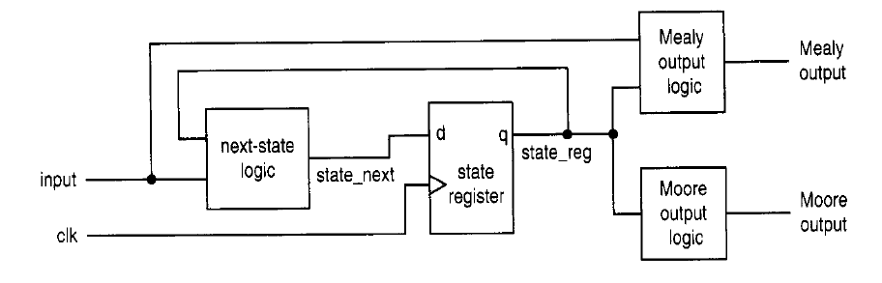
FSM
Moore: the output is only a function of state
Mealy : the output is a function of state and external input

Slide 7
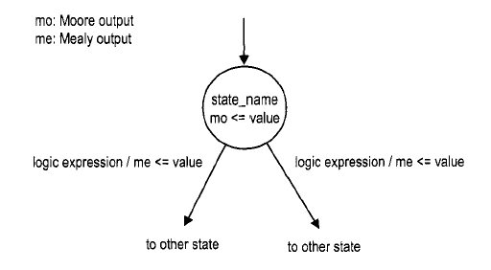
FSM representation
An FSM is usually specified by a state diagram
A state diagram is composed of nodes, which represent states and are drawn as circles, and annotated transitional arcs

Slide 8
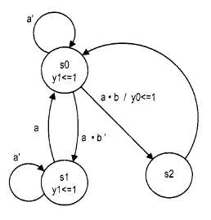
FSM modeling by VHDL
Example from “The designers guide to VHDL”, page 110
An FSM with both Mealy and Moore outputs

Slide 9
FSM modeling by VHDL
Use the VHDL‘s enumerated data type to represent the FSM’s states
3-process coding method
  Use one process for state transition, one for next state calculation, and one for output generation

Slide 10
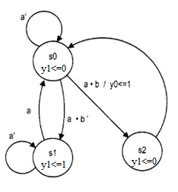
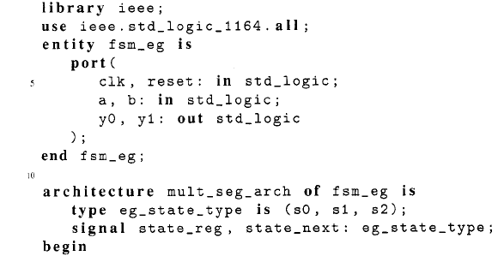
FSM modeling by VHDL

Slide 11
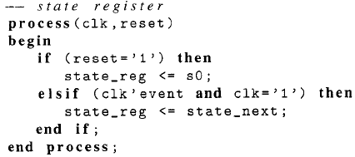
PROCESS-1: State transition

Slide 12
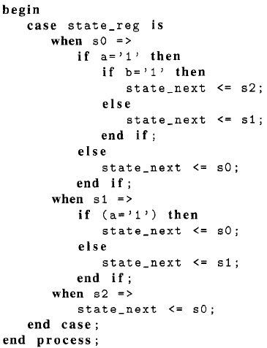
PROCESS-2: State calculation

Slide 13
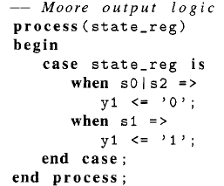
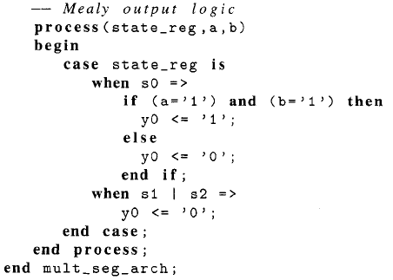
PROCESS-3: Output generation

Slide 14
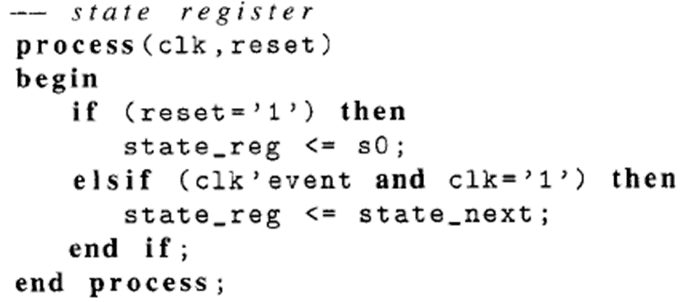

Slide 15
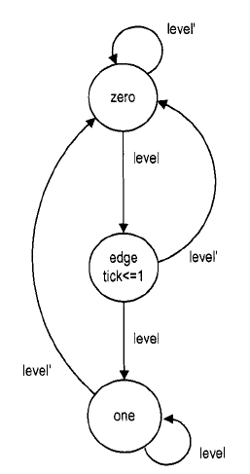
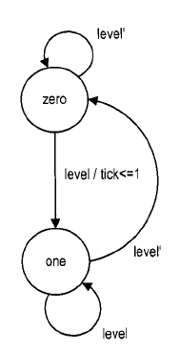
Example- Rising-edge detector
Moore Mealy
The zero and one states indicate that the input
signal has been ’0’ and ’ 1’ for awhile

Slide 16
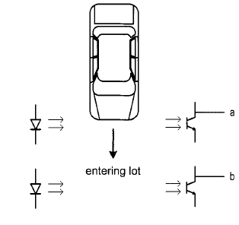
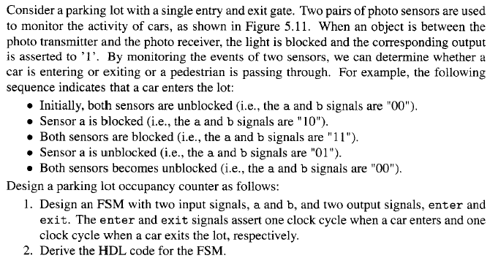
Exercise
Design an FSM with two input signals a and b, and 4 output signals P_in, P_out, C_in, C_out that assert one clock signal when a pedestrian enters, a pedestrian exits, a car enters, and a car exits, respectively.
Implement the FSM by VHDL

Slide 17
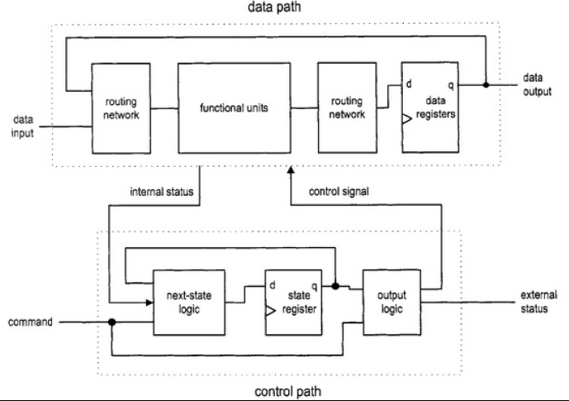
FSMD
Finite state machine with datapath
Combines an FSM and regular sequential circuits

Slide 18
RTL
The FSMD is used to implement systems described at the Register Transfer Level (RTL)
An RT operation specifies data manipulation and transfer for a single destination register
rdest ← f(rsrc1, rsrc2,…,rsrcn)
Elementary operations - called microoperations
  load, count, shift, add, bitwise "OR", etc.
  Example:
    R0← R1 ⊕ R2
    R6← R7+R8-1

Slide 19
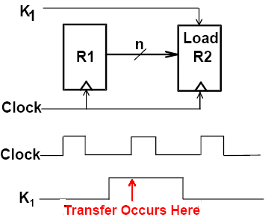
RT description methodology
Arrow (→): data transfer
  e.g. R1 ← R2
Brackets [ ]: Specifies a memory address
  e.g. R0 ← M[AR]
Comma: separates parallel operations
Colon: states a condition
  K1: (R2 ← R1)
  Means:
  If (K1 =1) then (R2 ← R1)

Slide 20
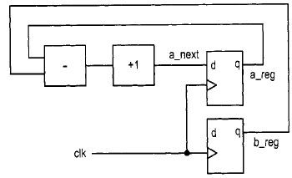
RTL
RT operations are synchronized by an embedded clock
The result from the f (.) function is not stored to the destination register until the next rising edge of the clock
a ← a-b+l

Slide 21
RTL
A circuit based on the RT methodology specifies which RT operations should be executed in each step
An RT operation is done in a clock-by-clock basis
  Its timing is similar to a state transition of an FSM

Slide 22
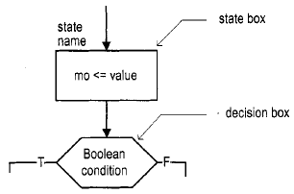
ASM chart
ASM: algorithmic state machine
Composed of a network of ASM blocks
  State blocks: represents a state in an FSM
  Decision blocks: tests the input condition and determines which exit path to take

Slide 23
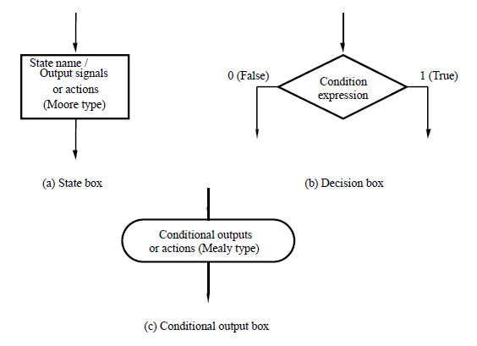
Elements of ASM chart

Slide 24
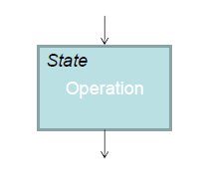
State box
The symbol is a rectangle, with a label (state name) and output control operations(Moore type) written inside
It has a single exit path (arrow)

Slide 25
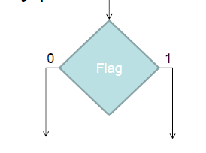
Decision box
The symbol is a diamond
A condition variable and multiple exit paths, labeled with values of the input condition
It has a single entry path.

Slide 26
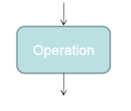
Conditional output box
The symbol is a rounded rectangle
Denotes output signals that are of the Mealy type.
Always after a decision box
Single entry and exit path

Slide 27
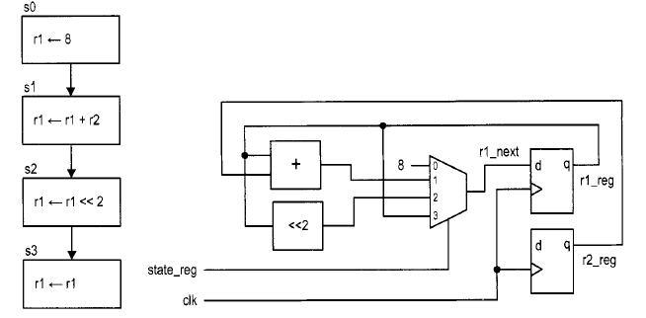
ASMD chart
ASM with datapath
A clock is embedded in the chart
  Registers are updated when exiting the current ASMD block

Slide 28
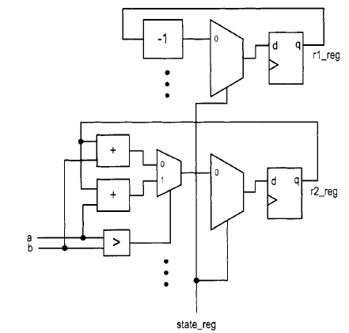
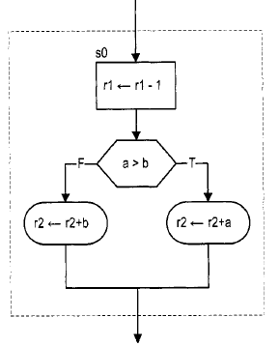
ASMD chart

Slide 29
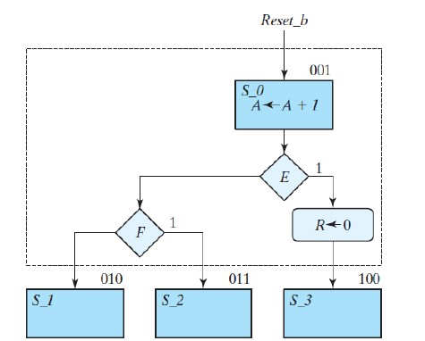
ASM block
ASM block

Slide 30
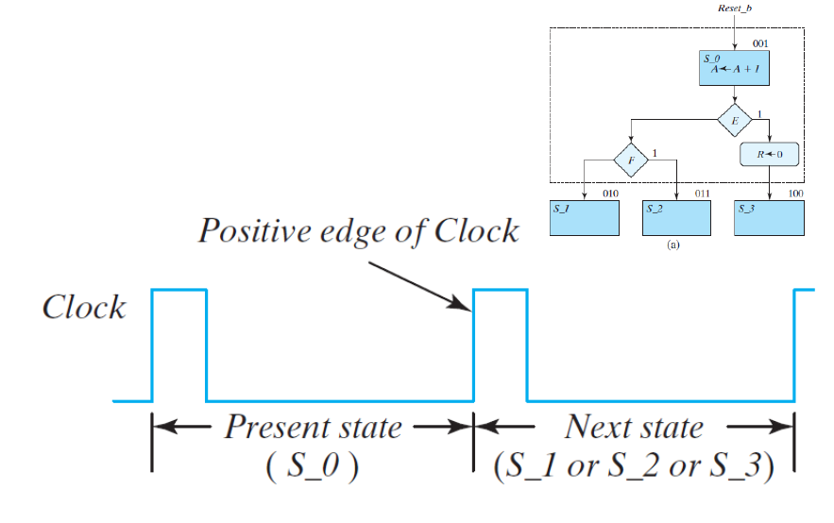
ASMD timing
Control passes one branch in the ASM block during the clock period and waits for the clock to enter the next state box

Slide 31
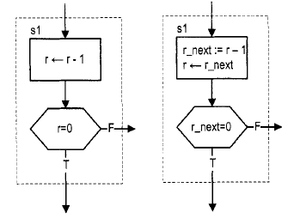
ASMD timing
The destination registers are updated when exiting the current ASMD block, but not within the block
  May introduce errors when a register is used in a decision box
If the new value of r is desired, we should use r_next, the output of the combinational logic
“ := “ is used for
immediate assignment

Slide 32
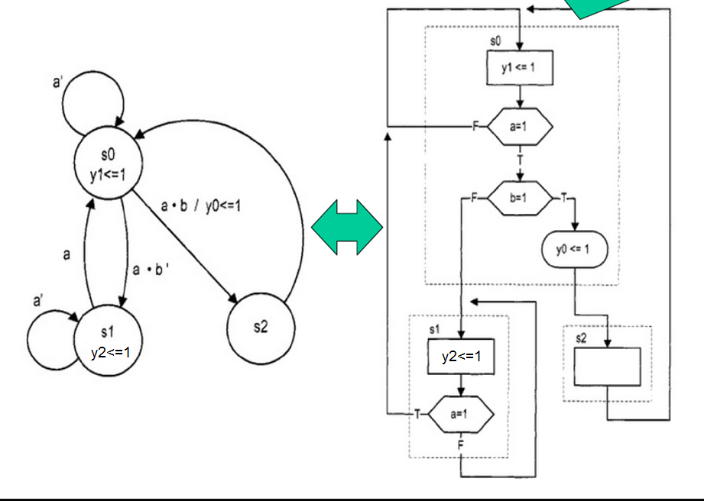
State diagram- ASM equivalence
Source: EE 459/500 – HDL Based Digital Design with Programmable Logic

Slide 33
State diagram- ASM equivalence
Source: EE 459/500 – HDL Based Digital Design with Programmable Logic

Slide 34
ASMD chart

Slide 35
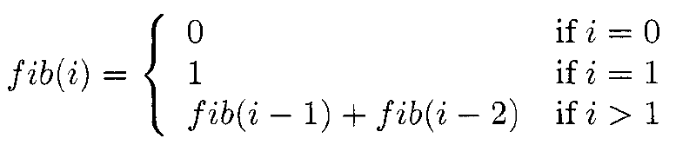
Example: Fibonacci number
Fibonacci number circuit
A sequence of integers

Slide 36
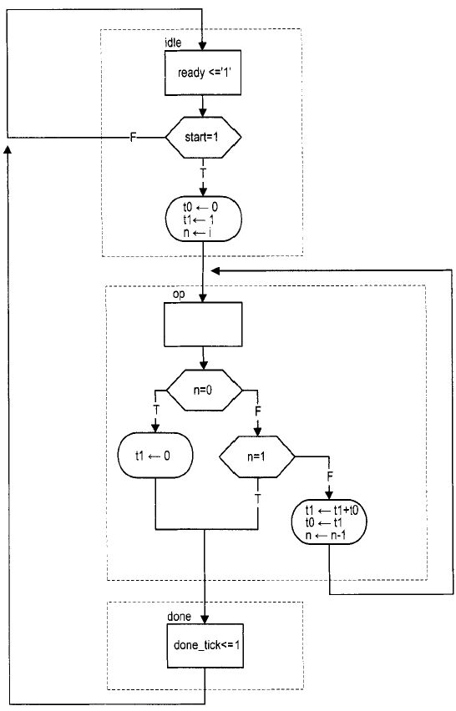
ASMD
tl and t0 are temporary storage registers
n is the index register
Input:
  i: the number of required iterations
  Start: Commands the beginning of operation
Output:
  F: the last generated number
  Ready: indicates that the circuit is idle and ready to take new input
  done-tick: asserted for one clock cycle when the operation is completed

Slide 37
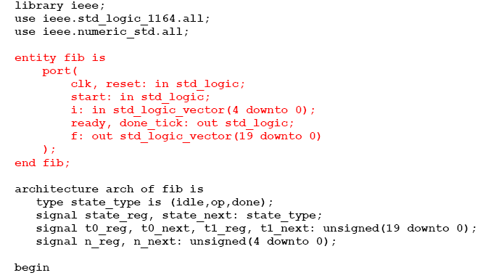
VHDL code

Slide 38
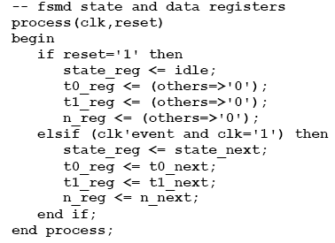
VHDL code
We use a 3-process implementation, much like the FSM implementation in previous lecture
  but we should also handle the datapath registers in the next state calculation and assignment processes
Process 1: State and datapath register assignment

Slide 39
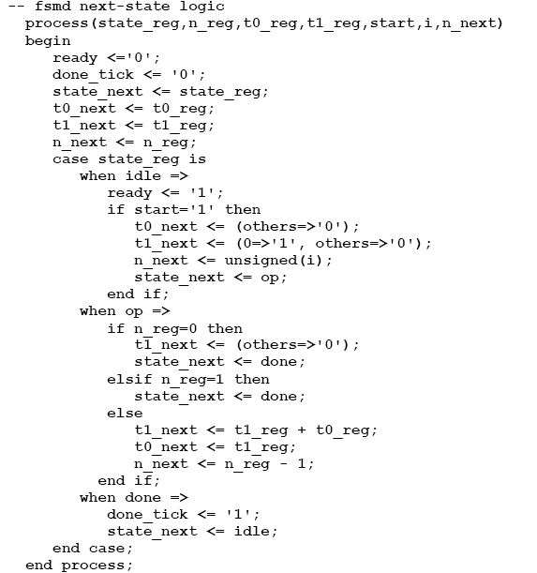

Process 2: next state and datapath register
Process 3: output generation, we actually use a dataflow assignment, as the output is very simple

